Slide 1
CVDex: Bringing Pokémon to Life Through Real-World Image Recognition
By Jocelyn Dzuong, Cesar Santiago, Bryan Bravo, Roberto Hernandez

Slide 2

Problem Statement
The Problem
Frequent misclassification of Pokemon from people when referring to ads, shows, anywhere there's media
Lack of real-time, camera-based solution for identifying Pokemon from posters, cards, billboards, menus etc.
The Gap
Existing Pokedex apps focus on static 3D entities or manual input
No seamless integration of Pokemon image detection exists on mobile
What We Aim to Solve
Create a user-friendly app that detects Pokemon in real-time using a camera and provides accurate Pokedex entries

Slide 3

Project Landscape
Technological Landscape
Flutter: Cross-platform framework for seamless UI
PyTorch: Cutting-edge object detection for real-time performance
PokeAPI: Trusted source for data retrieval
Firebase: Backend for user data storage and leaderboard functionality
Competitive Analysis
Strengths:
Efficient model inference of images
Fully automated integration with a visual Pokedex UI
Weaknesses in Competitors:
Manual data input in competing apps
No integration of live ML object detection with databases

Slide 4

High-Level System Overview
User registers account and logs in
Pokedex entry scoring and display
Camera input with model object detection
Prediction from model to parse as a request to PokeAPI

Slide 5
Team Contributions
Jocelyn
Front-End, Project Management, DevOps, Machine Learning
Roberto
Database Management, Camera Integration, Project Management, Backend
Bryan
Backend, User Administrator, Database Management, API Integration
Cesar
Machine Learning, API Integration, User Administrator

Slide 6

Demo Time!

Slide 7
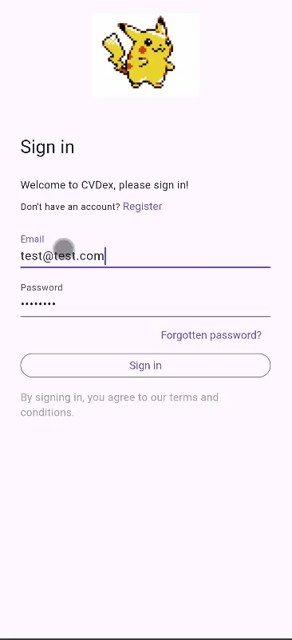

Slide 8

Software Verification

Slide 9
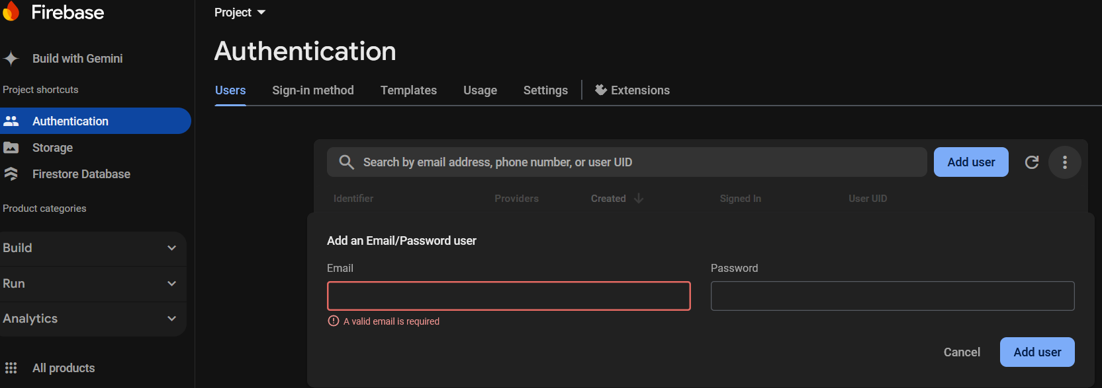
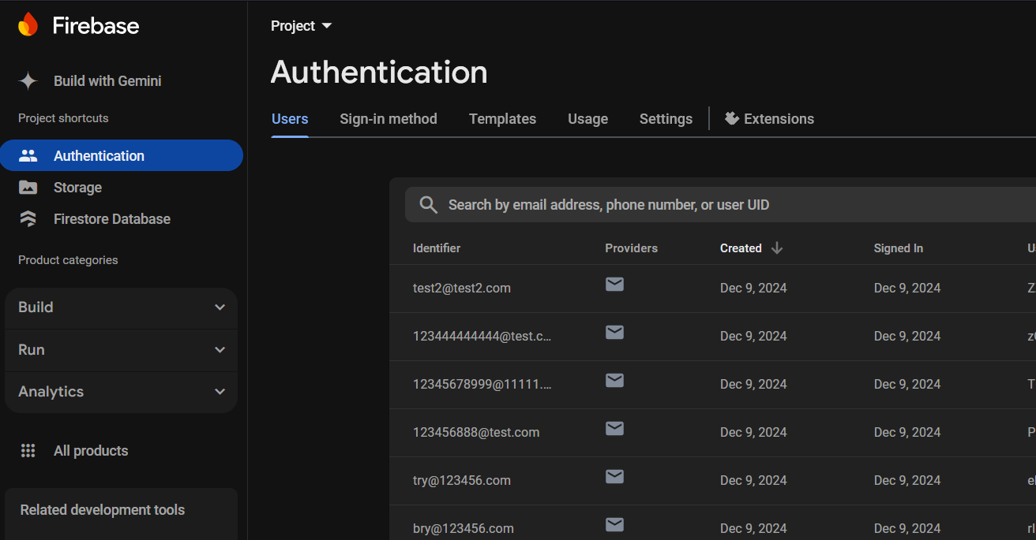
Testcase #1
Successful retrieval of user data from the database, and data integrity for stored records

Slide 10
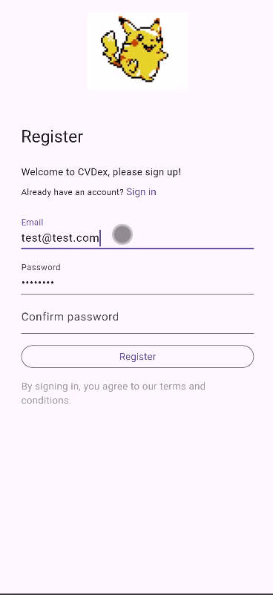
Testcase #2
Successful account creation via test email

Slide 11
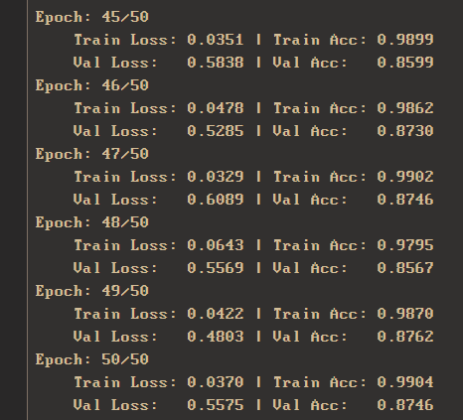
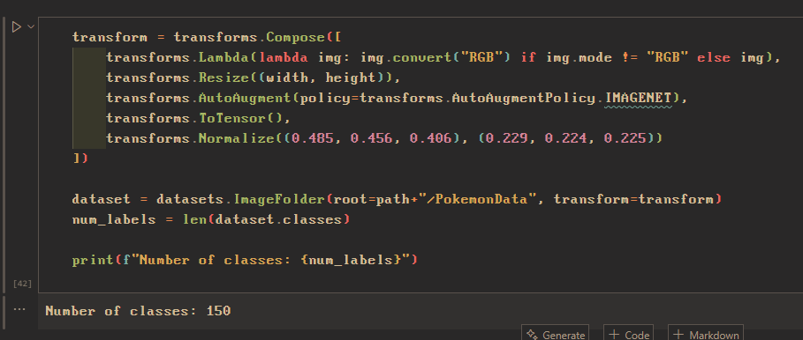
Testcase #3
PyTorch model is trained on 100+ Pokemon, the app IDs at least 85% of scanned images correctly and that the model is functional

Slide 12
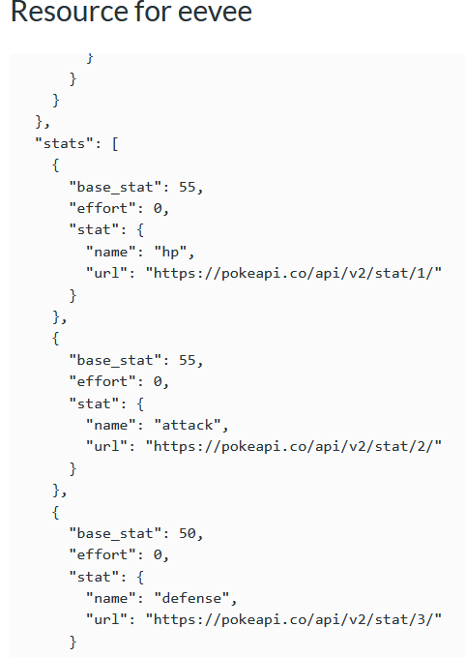
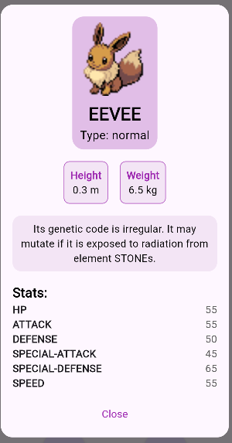
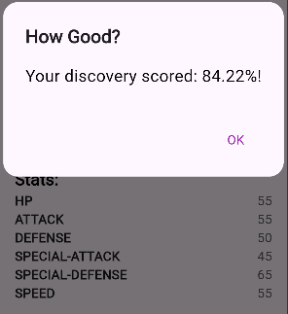
Testcase #4
Verify the PokeAPI returns requested data, and that the details match the predicted image.

Slide 13
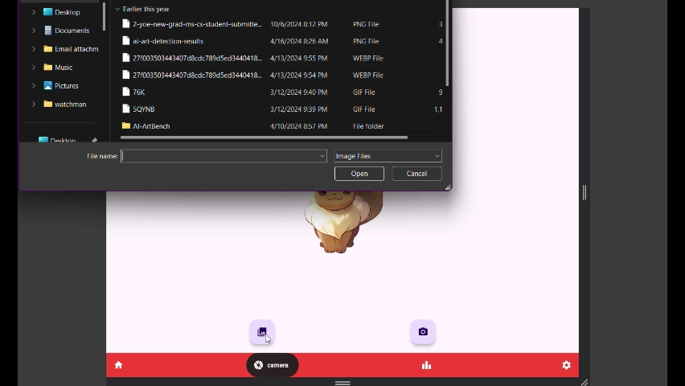
Testcase #5
Verify interface responsiveness according to modern accessibility and design standards.

Slide 14
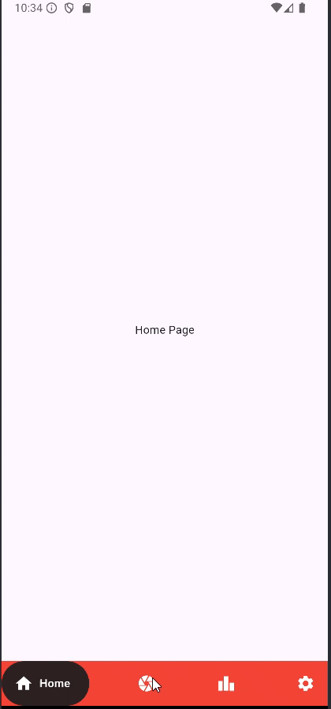
Testcase #6
Verify the app can activate the camera to identify Pokémon through the camera

Slide 15
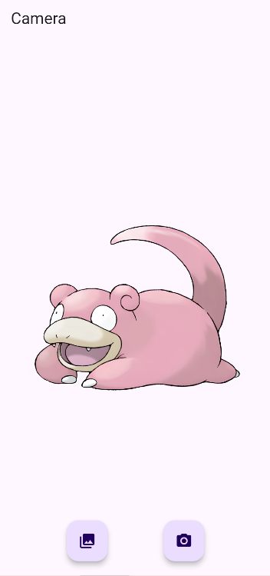
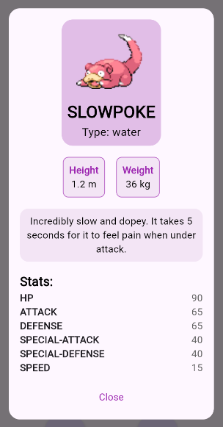
Testcase #7
Verify data is displayed in a user-friendly layout where the font and design is consistent all the way

Slide 16
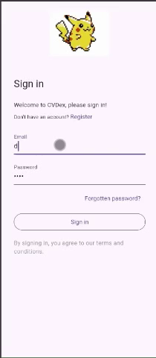
Testcase #8
Verify login functionality with existing credentials, access to account profile, and proper error messages for incorrect credentials.

Slide 17
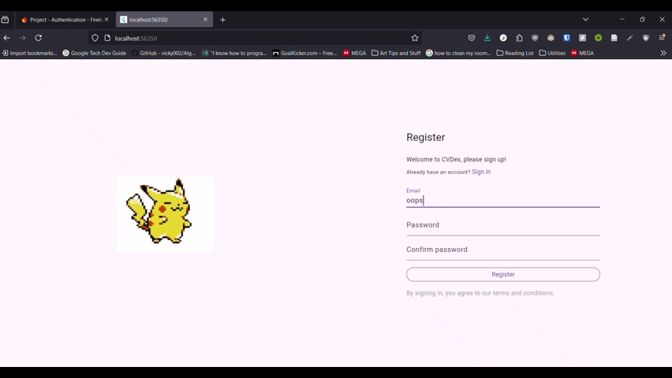
Testcase #9
Verify account deletion removes data from the database, and that deleted accounts cannot log in.

Slide 18
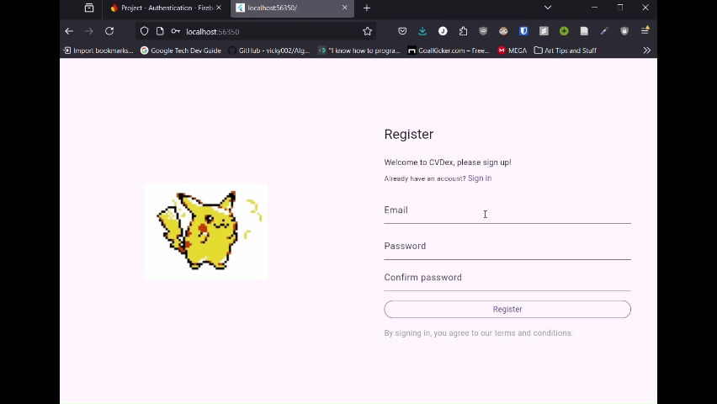
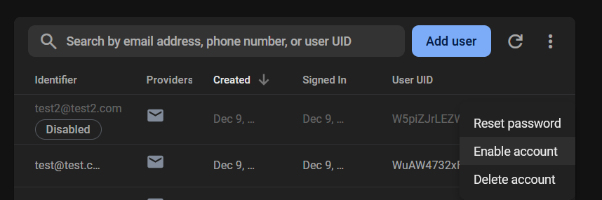
Testcase #13
Verify admin can ban a user by username, banned users cannot login, and unbanned users can regain account access.

Slide 19
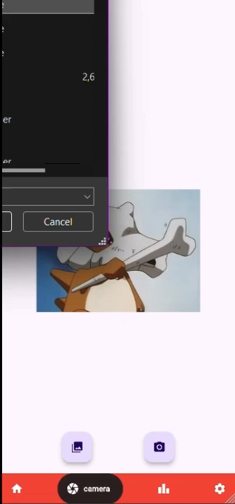
Testcase #14
Verify the model returns a score for each image, and that the score is displayed in the UI.

Slide 20

Problem Resolution
How We Solved the Problem
Bridging the gap with seamless integration of PyTorch inference and PokeAPI for accurate Pokemon identification
Scoring for guidance
Compact and responsive UI
Impact
Seamless, accessible user experience (UX) for Pokemon enthusiasts
Potential for gamified learning, immersion of having a Pokedex on mobile in your hands!

Slide 21
Future Changes
Persistent Entry Storage
Save scanned Pokedex entries in a responsive grid manner on the homepage
Display TCG Data
Give users option to view and store TCG data after model inference

Slide 22
References
External Sources:
Flutter documentation: https://flutter.dev/
PyTorch framework: https://pytorch.org/
PokéAPI: https://pokeapi.co/
Firebase documentation: https://firebase.google.com/
Relevant Articles
Jiang, M., et al. “An Empirical Study in Software Verification Tools.” 2020 International Symposium on Theoretical Aspects of Software Engineering (TASE), 1 Dec. 2020, pp. 201–208, https://doi.org/10.1109/tase49443.2020.00035. Accessed 2 Dec. 2024.
Princeton University, “How To Design For Accessibility,” Digital Accessibility at Princeton, 2024. https://digital.accessibility.princeton.edu/how/design

Slide 23

Thank You!

